Slide 1
Machine Learning Basics
LiChia (Jerry) Chang

Slide 2
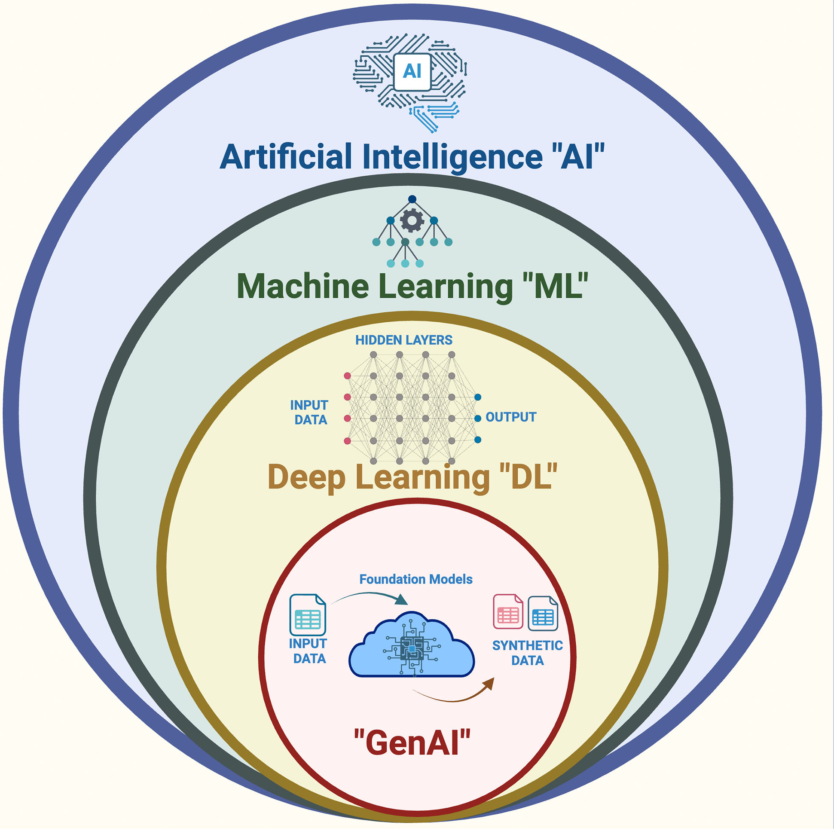
AI Evolution

Slide 3
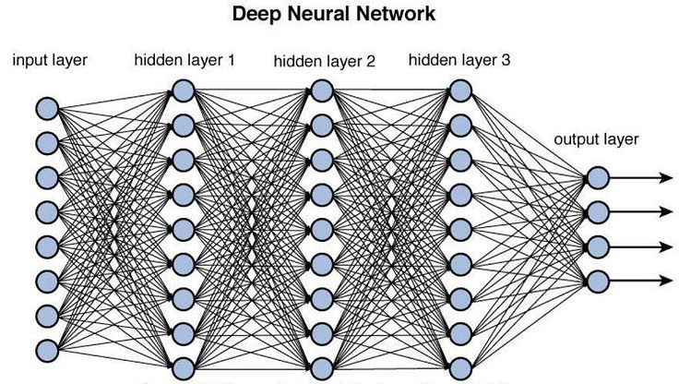
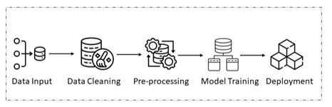


Overview of AI Pipeline Evolution
Get this worked
Sure

Slide 4
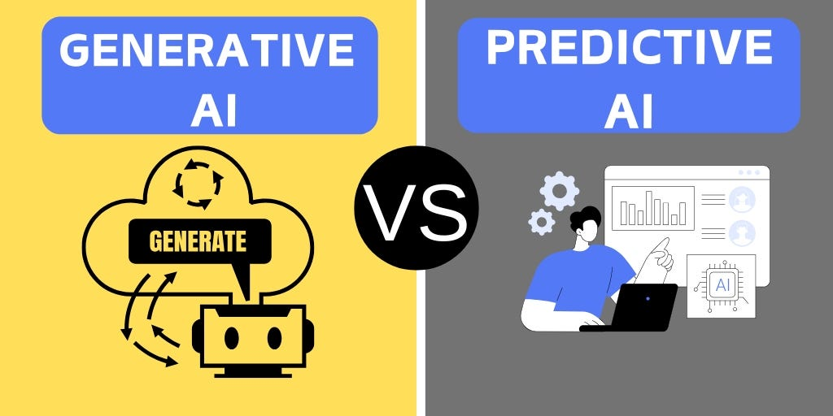

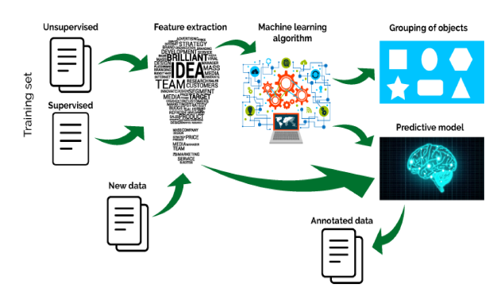
In the post Chatgpt era…
Models:
Transformer
Tasks:
Question answering
Image generation
Models:
DNN, CNN, RNN
Tasks:
Regression
Classification

Slide 5
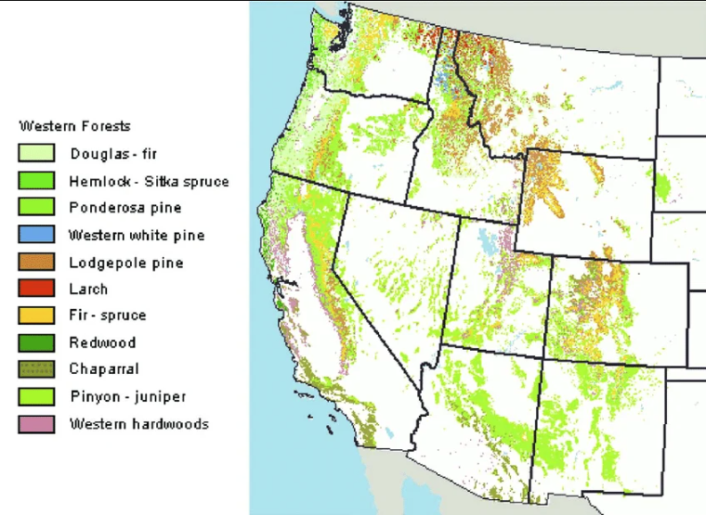
Case Study: Forest Covertype Prediction
Natural resource managers need basic forest inventory data to develop ecosystem management strategies, but often lack such information for nearby lands outside their jurisdiction. Predictive models offer a way to obtain it.
One method of obtaining this information is through the use of predictive models.

Slide 6
Forest Covertype Prediction
50000 samples
54 features
7 forest covertypes

Slide 7
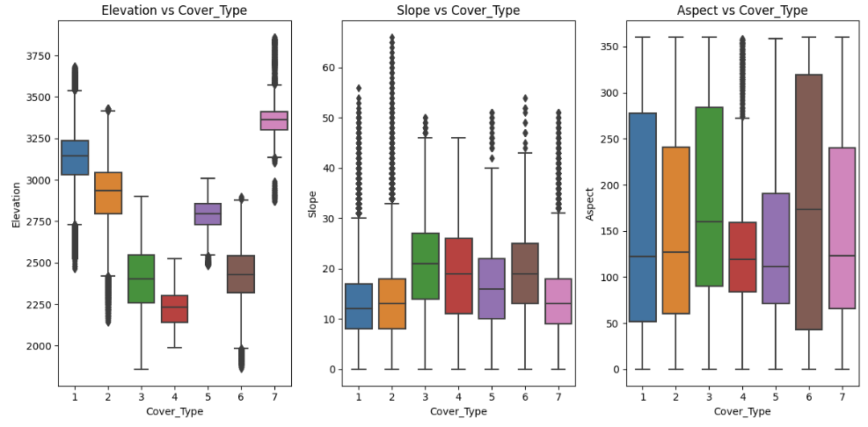
Forest Covertype Prediction: Data Cleaning

Slide 8
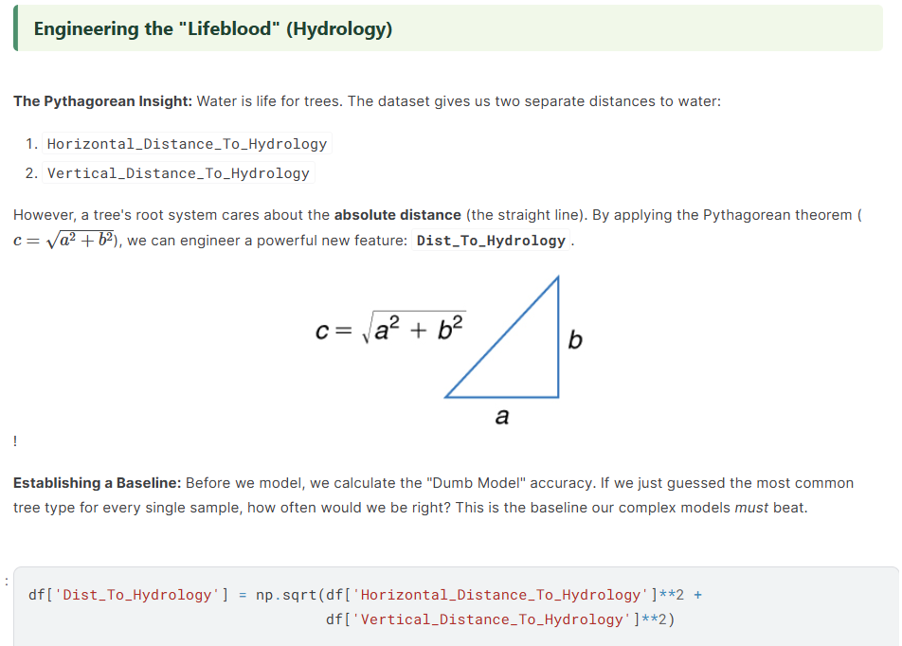
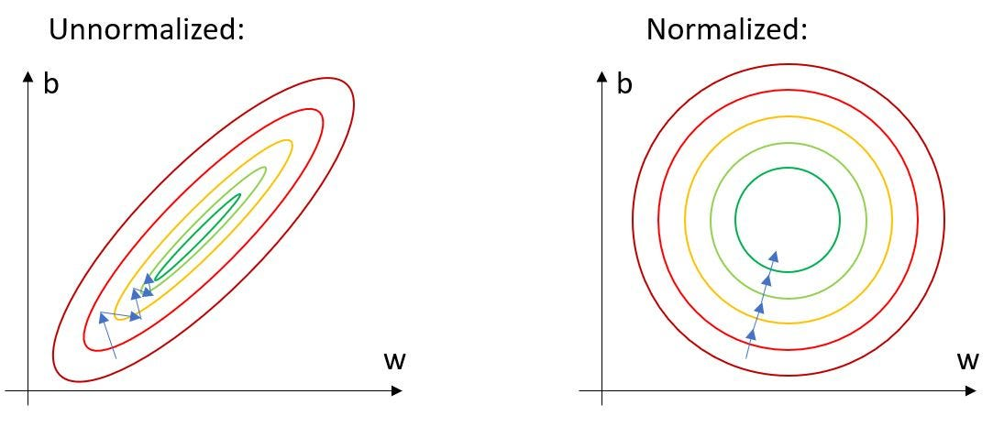
Forest Covertype Prediction: Preprocessing

Slide 9
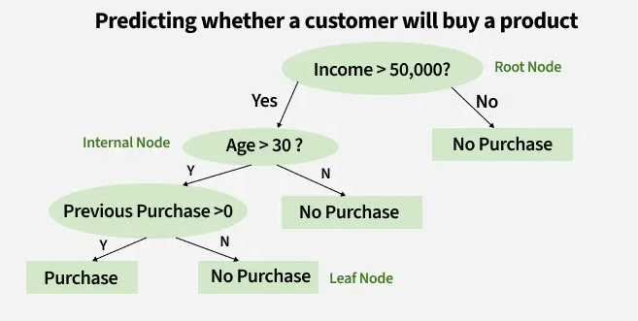
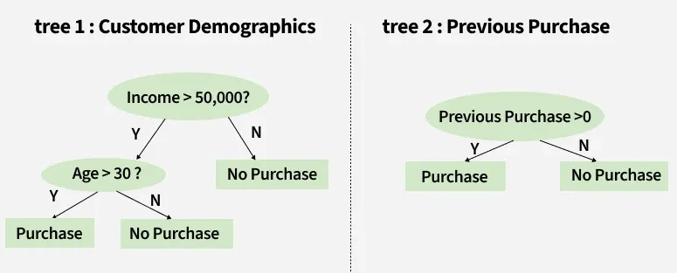
Forest Covertype Prediction: Model Training
Random Forest Classifier
Criterion: attribute selection measures

Slide 10
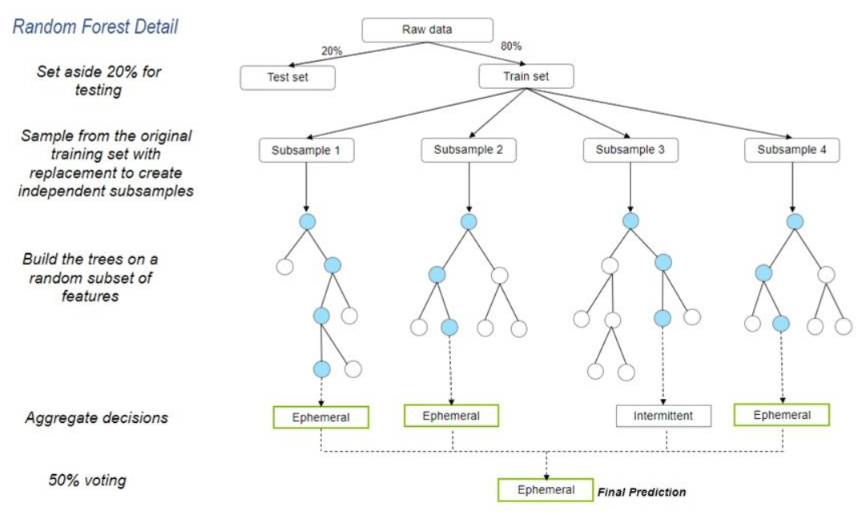
Forest Covertype Prediction: Model Training
Random Forest Classifier

Slide 11
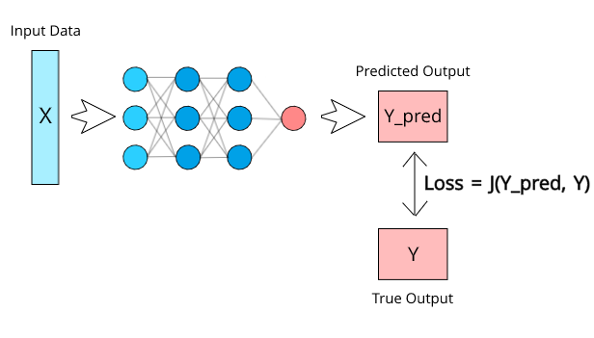
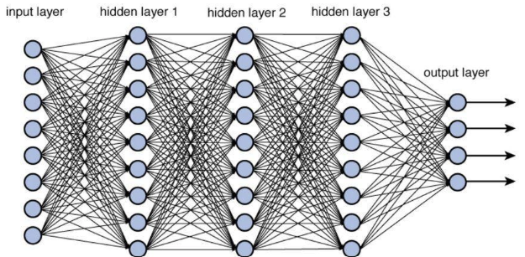
Forest Covertype Prediction: Model Training
Deep Neural Network

Slide 12
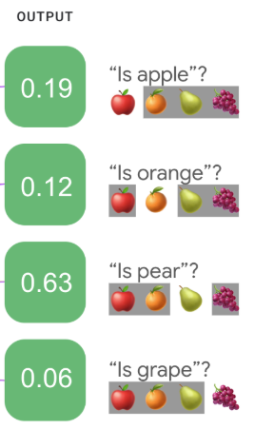
Forest Covertype Prediction: Model Training
Deep Neural Network
Loss function / Criterion:
Cross Entropy Loss
Optimizer:
True label
[0
0
1
0]
CrossEntropy

Slide 13
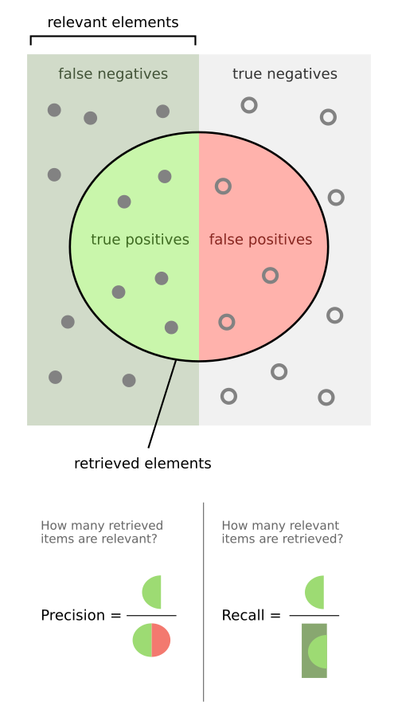

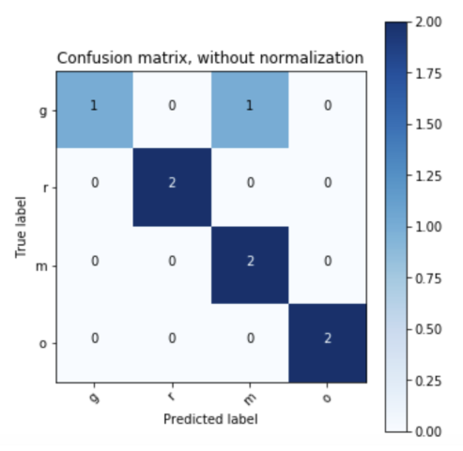
Forest Covertype Prediction: Evaluation
F1-score:
Confusion matrix:

Slide 14
Coding Time!

